Slide 1
Consistent Query Answering: a personal perspective
Marcelo Arenas
Leopoldo Bertossi Special Event - AMW 2017

Slide 2
How did I meet Leo?
Back in 1993 I was an undergrad student in computer engineering at PUC Chile
I was about to quit to move to math
I had the impression that computer engineering was essentially about programming
But then I took the course Logic in Computer Science given by Leo

Slide 3
What did I learn in Logic in Computer Science?
It was my first exposure to computer science
I was fascinated by the mathematic formalization of the idea of computation
I learnt about Turing Machines, reductions, undecidable problems and NP-completeness!
I learnt about the importance of logic for computer science

Slide 4
How popular was this course?
The failure rate of this course was 60%
It was not a popular course ☺
But it was one of the best courses in computer engineering!
And I didn’t quit computer engineering
I decided to do both computer engineering and math ☺

Slide 5
What happened next?
I was a TA for Logic in Computer Science for four years
I took every course that Leo gave
I learnt about many things: computational complexity, logic programing, logic and knowledge representation
I joined Leo’s research group

Slide 6
Were we always happy?
I don’t remember the exact date, but I remember the first time Leo was really mad at me
The exercise:
Prove that a language L is in NP if and only if there exists a binary relation R in PTIME and a polynomial p such that:
∀x: x∈L if and only if ∃y |y|≤ p(|x|) and (x,y)∈R

Slide 7
Leo as a Master’s supervisor
I entered the Master’s program in 1997 under Leo’s supervision
He told me about a very interesting problem that he discussed with Jan Chomicki: extracting information from an inconsistent database, but without repairing it
This gave rise to consistent query answering
I will come back to this a bit later

Slide 8
The impact of Leo at PUC Chile
We learnt about many important subjects from Leo
We learnt about the importance of research
And the importance of being rigorous in computer science
He taught us about the importance of data management
Leo had a background on mathematical logic, and he initially did research on AI
I did a Ph.D. on databases because of his influence

Slide 9
The impact of Leo in Chile
Leo
Arenas
Barceló
Bravo
Riveros
Pérez
Reutter
PUC Chile
U. de Chile
UDD

Slide 10
Consistent query answering
Employee(name, salary) name → salary
name | salary
Ron | 100K
John | 90K
Paul | 70K
name | salary
Ron | 100K
Ron | 110K
John | 90K
Paul | 70K

Slide 11
Consistent query answering
Employee(name, salary) name → salary
Q₂(x) = ∃y Employee(x,y)
name | salary
Ron | 100K
John | 90K
Paul | 70K
Q₁(x,y) = Employee(x,y)
Ron | 100K
John | 90K
Paul | 70K
Ron
John
Paul

Slide 12
Consistent query answering
Employee(name, salary) name → salary
Q₂(x) = ∃y Employee(x,y)
name | salary
Ron | 100K
Ron | 110K
John | 90K
Paul | 70K
Q₁(x,y) = Employee(x,y)
John | 90K
Paul | 70K
Ron
John
Paul

Slide 13
CQA: the main idea
Employee(name, salary) name → salary
name | salary
Ron | 100K
John | 90K
Paul | 70K
name | salary
Ron | 100K
Ron | 110K
John | 90K
Paul | 70K
name | salary
Ron | 110K
John | 90K
Paul | 70K

Slide 14
CQA: the main idea
Q₂(x) = ∃y Employee(x,y)
Q₁(x,y) = Employee(x,y)
name | salary
Ron | 100K
John | 90K
Paul | 70K
Ron | 100K
John | 90K
Paul | 70K
Ron
John
Paul
name | salary
Ron | 100K
Ron | 110K
John | 90K
Paul | 70K
Ron
John
Paul
John | 90K
Paul | 70K
name | salary
Ron | 110K
John | 90K
Paul | 70K
Ron | 110K
John | 90K
Paul | 70K
Ron
John
Paul

Slide 15
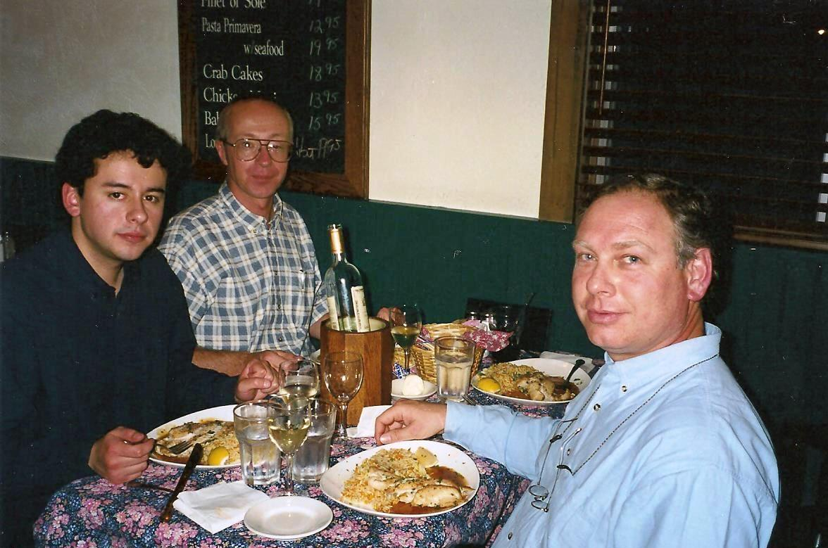
PODS 1999: Consistent Query Answers in Inconsistent Databases

Slide 16
What was in the paper?
Definition of consistent answer for arbitrary integrity constraints
Including a definition of repair
A general methodology for computing consistent answers based on query rewriting
A query rewriting algorithm for computing consistent answers (in some cases)

Slide 17
CQA: a gentle introduction
Fix a schema (S,IC) and a database instance D of (S,IC)
S is a set of relation schemas and IC is a set of integrity constraints
We view D as a set {P(a), P(b), Q(a,b), Q(a,c), R(c)} of facts
The distance between D₁ and D₂, denoted by ∆(D₁,D₂), is defined as (D₁ – D₂) ∪ (D₂ – D₁)

Slide 18
Definition of repair
The previous definition gives rise to a partial order: D₁ ≤ D₂ if and only if ∆(D₁,D) ⊆ ∆(D₂,D)
D₁ is a repair of D if:
D₁ ⊨ IC
D₁ is a ≤-minimal element of { D₂ | D₂ ⊨ IC }
There is no D₂ such that D₂ ⊨ IC and ∆(D₂,D) ⊊ ∆(D₁,D)

Slide 19
Examples of repairs
Employee(name, salary) name → salary
name | salary
Ron | 100K
John | 90K
Paul | 70K
name | salary
Ron | 100K
Ron | 110K
John | 90K
Paul | 70K
name | salary
Ron | 110K
John | 90K
Paul | 70K

Slide 20
Definition of consistent answer
Fix a query Q(x) and a tuple t
We use notation D ⊨ Q(t) to indicate that t is an answer to Q over D (in the usual sense)
t is a consistent answer to Q(x) over D if Q(t) holds in every repair of D
We use notation D ⊨_{c} Q(t)
Then D ⊨_{c} Q(t) if and only if D₁ ⊨ Q(t) for every repair D₁ of D

Slide 21
Examples of consistent answers
Q₂(x) = ∃y Employee(x,y)
Q₁(x,y) = Employee(x,y)
name | salary
Ron | 100K
John | 90K
Paul | 70K
Ron | 100K
John | 90K
Paul | 70K
Ron
John
Paul
name | salary
Ron | 100K
Ron | 110K
John | 90K
Paul | 70K
Ron
John
Paul
John | 90K
Paul | 70K
name | salary
Ron | 110K
John | 90K
Paul | 70K
Ron | 110K
John | 90K
Paul | 70K
Ron
John
Paul

Slide 22
Computing consistent answers
name → salary
name | salary
A₁ | B₁
A₁ | C₁
A₂ | B₂
A₂ | C₂
. . .
A_{n} | B_{n}
A_{n} | C_{n}
We have 2^{n} repairs!

Slide 23
A general methodology for computing consistent answers
Given a query Q(x), compute a query Q₁(x) such that for every database instance D and tuple t:
D ⊨_{c} Q(t) if and only if D ⊨ Q₁(t)
Q₁ is called a rewriting of Q
This approach gives polynomial-time data complexity
It allows to rely on well-known relational database technology to compute consistent answers

Slide 24
Examples of consistent answers
name → salary
Q(x,y) = Employee(x,y)
name | salary
Ron | 100K
Ron | 110K
John | 90K
Paul | 70K
John | 90K
Paul | 70K
Q₁(x,y) = Employee(x,y) ∧
∀z (Employee(x,z) → y = z)

Slide 25
A query rewriting algorithm for computing consistent answers
It can be used for universal integrity constraints
A functional dependency name → salary is a universal constraint:
∀x∀y∀z (Employee(x,y) ∧ Employee(x,z) → y = z)
The algorithm is based on the use of resolution
Universal constraints are viewed as first-order clauses:
∀x∀y∀z (¬Employee(x,y) ∨ ¬Employee(x,z) ∨ y = z)

Slide 26
A query rewriting algorithm for computing consistent answers
A rewriting of a query Q(x) is generated by exhaustively applying resolution to the query
The rewriting of Q(x,y) = Employee(x,y) is
Q₁(x,y) = Employee(x,y) ∧∀z (¬Employee(x,z) ∨ y = z)
which is equivalent to
Employee(x,y) ∧∀z (Employee(x,z) → y = z)

Slide 27
A query rewriting algorithm for computing consistent answers
The algorithm generates an infinite query that is sound and complete for some classes of integrity constraints
For example, for functional dependencies
Some conditions that ensure that the generated query is finite are given in the paper
In particular, an acyclicity condition for sets of integrity constraints

Slide 28
The impact of Leo’s research
The paper in PODS 1999 has ~ 800 citations (Google scholar)
Leo continued this line of research and became one of the leading figures
He has several important publications on the area
Including one book

Slide 29
The impact of Leo’s research
Encyclopedia of Database Systems includes entries “Consistent Query Answering” and “Inconsistent Databases”
SIGMOD Jim Gray Doctoral Dissertation Award 2008 was given to Ariel Fuxman for his Ph.D. thesis “Efficient Management of Inconsistent Databases”
Paper published in ACM TODS in June 2017: Consistent Query Answering for Self-Join-Free Conjunctive Queries Under Primary Key Constraints (Koutris & Wijsen)

Slide 30
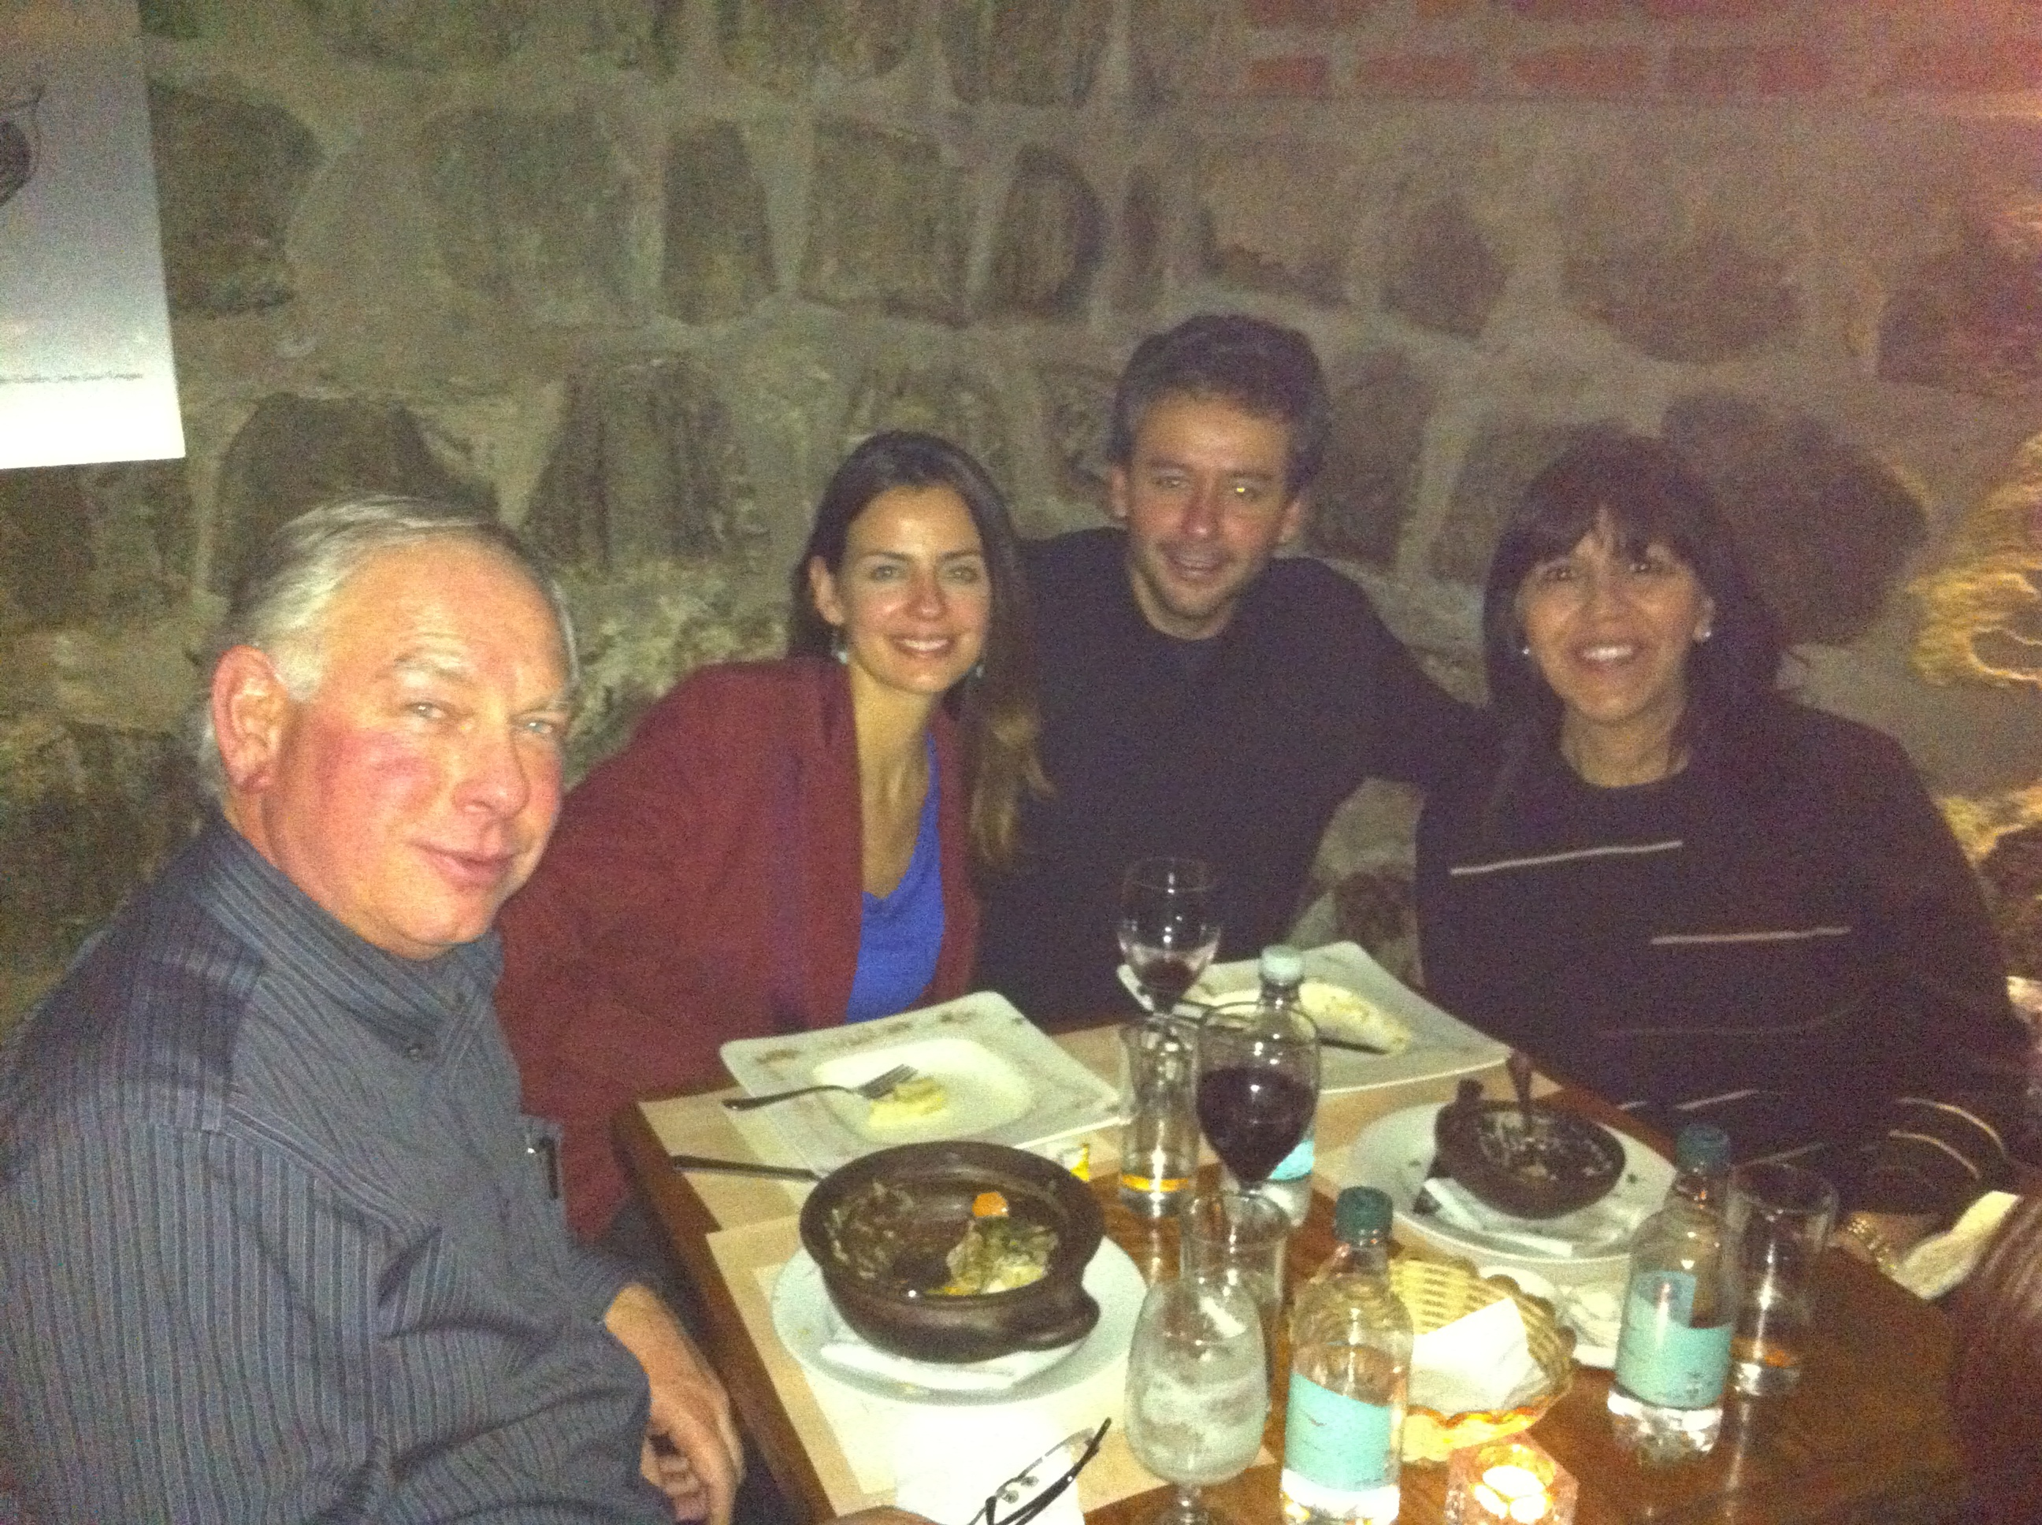
Thanks Leo for being a great mentor!

